Slide 1
Capstone Session 12

Slide 2
Deep Learning for Advanced Modeling

Slide 3



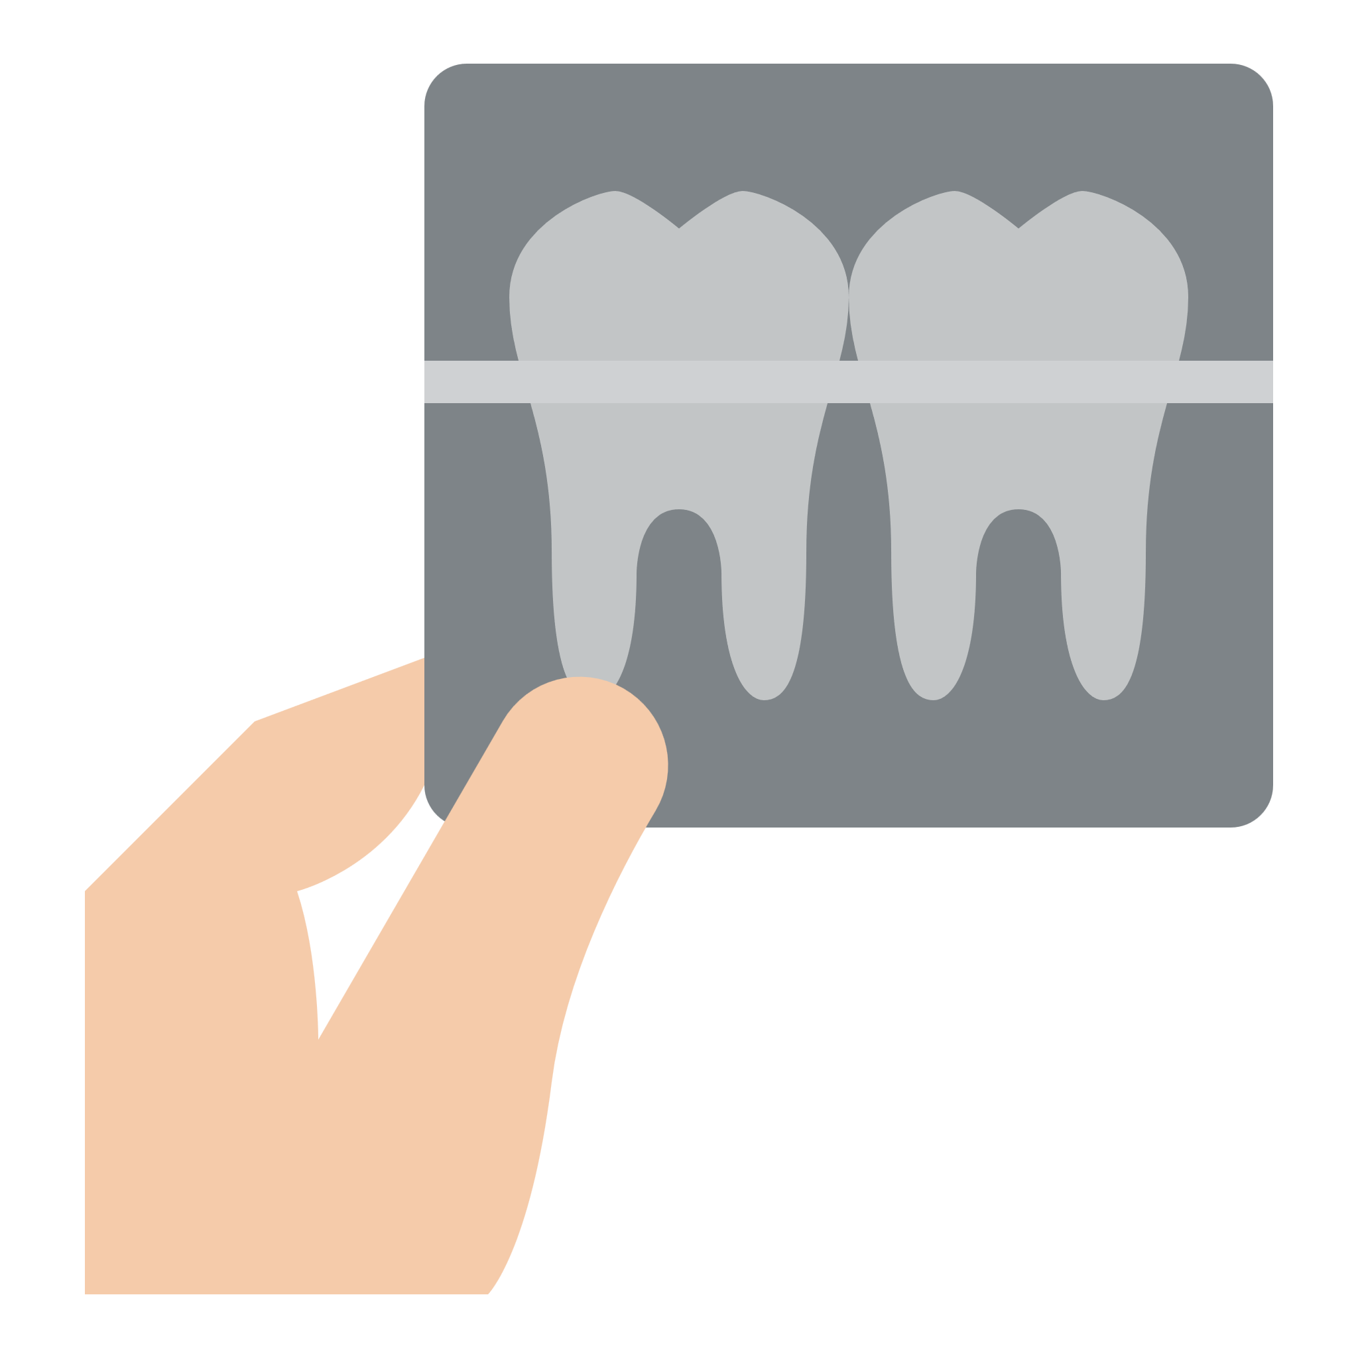
Deep Learning for Customer Insights
Aura must offer intuitive analyses that help customers make informed decisions to push relevant ads, services and products based on real-time user sentiments.
ClickO’s customers
Banking Organization
Movie Theater Owner
E-Commerce Company
Dental Clinic
Notes:
Trainer Notes:
Aura can provide intuitive analysis on image and text data for natural scene classification, face mask detection on humans, classify consumer products reviews, early detection of customers who might churn, and denoising of images. This helps customers of Aura make informed decisions to push relevant ads, services and products based on real-time user sentiments.
In this project, Aura will help customers in the following sectors:
Identify customers who may result in churn for a retail banking organization - churn can impact the topline and bottom line of the bank. The bank desires to cross-sell new digital banking products to such potential churn customers so that they reverse their decision to leave the bank.
Aura must support the Realtors Association of California with their new platform where they will showcase premium houses for sale. The platform must classify Natural Scene images into buildings, forest, glacier, mountain, sea and street. This feature will be used to distinguish between human users and bots to reduce spam on the platform.
In the post-pandemic scenario, as cinemas across the US open again, a large cinema property owner MMC Sercado wants to detect humans who are wearing face masks correctly, incorrectly and not wearing at all. Those who are not wearing face masks will be sold mandatory masks at $8 per mask (an up-sell opportunity at the cinema).
Aura’s e-commerce customer getmeatshirt.com desires to classify customer product reviews into good or bad.
Boston Dental Clinic is an old ClickO customer who wishes to use Aura’s ML/DL capabilities to retain old patients and provide better service. The clinic is looking at cleaning its older X-Ray Database by denoising poorer X-Rays. A market research analysis has found that providing better quality historical X-rays is a sure-shot way of retaining customers.
Images:
https://www.flaticon.com/premium-icon/face-detection_3041270?related_id=3041270&origin=search
https://www.flaticon.com/free-icon/medical-mask_2750656?term=face%20masks&page=1&position=18&page=1&position=18&related_id=2750656&origin=search
https://www.flaticon.com/premium-icon/add-to-cart_3649281?related_id=3649281&origin=search
https://www.flaticon.com/free-icon/x-ray_4100972?related_id=4100972&origin=search

Slide 4
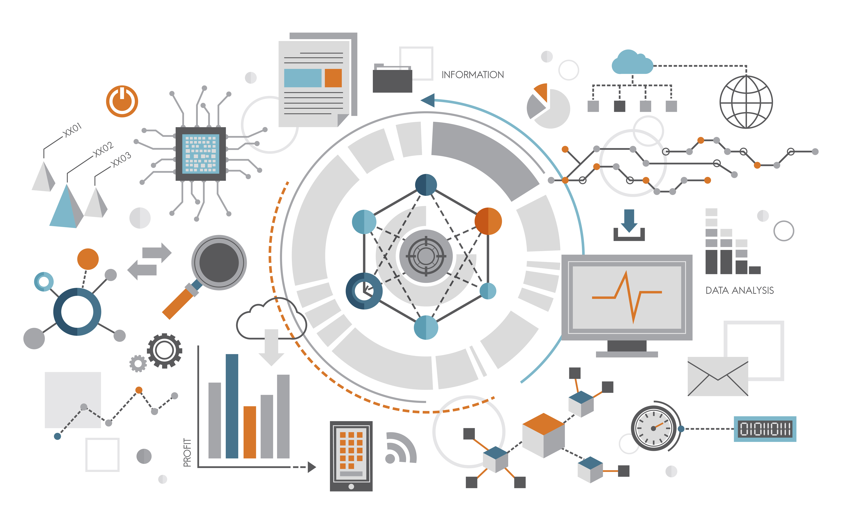
Project Statement
Build necessary data aggregation, wrangling, and visualization modules for Aura using the Healthcare dataset.
Identify customers who churn the bank
Detect humans wearing face masks
Classify customer product reviews
Denoise dirty documents
Notes:
Trainer Notes:
Project Statement
Aura must:
Identify customers who might churn the bank
Classify the Natural Scenes images into buildings, forest, glacier, mountain, sea and street.
Detect humans who are wearing face masks correctly, incorrectly and not wearing at all
Classify customer product reviews into good or bad
Denoise dirty documents into cleaner documents.
https://www.freepik.com/free-vector/illustration-data-analysis-graph_2807756.htm#page=2&query=data%20analysis&position=16&from_view=search

Slide 5
Session 9 12: Dataset Description
Variable | Description
Image File Name | Name of the image file [name is a number from 1-116]
Notes:
Trainer Notes:
This is the dataset description for the current week’s task.
Note: Use Dental-Panaromic-Autoencoder.npz for this task.

Slide 6
Session 12: Enhancing Dental X-rays with Autoencoders
Task: Build an autoencoder model to improve the clarity of dental X-rays (denoise the X-rays) using the dental panoramic dataset.
Dataset: Dental-Panaromic-Autoencoder.npz
This dataset consists of anonymized and de-identified panoramic dental X-rays of 116 patients, taken at Noor Medical Imaging Center, Qom, Iran. The subjects cover a wide range of dental conditions from healthy, to partial, and complete edentulous cases. The mandibles of all cases are manually segmented by two dentists. The dataset is saved in compressed NumPy format which when loaded using numpy.load will give you x_train, y_train, x_test and y_test NumPy arrays respectively.
Notes:
Note to Simplilearn: This dataset has been customized using the Panoramic Dental X-rays With Segmented Mandibles

Slide 7
Session 12: Enhancing Dental X-rays with Autoencoders
Task A:
Load the Dental-Panaromic-Autoencoder.npz dataset using NumPy.load.
Note: NPZ is a file format by NumPy that provides storage of array data using gzip compression.
Extract x_train, y_train, x_test and y_test numpy arrays from the dataset
A noisy version of the dataset will be created by applying random noise to each image.
With a noise factor of 0.2, add noise to the signal by multiplying the noise factor and random values from a normal distribution.
Hint:
noise_factor = 0.2
x_train_noisy = x_train + noise_factor * tf.random.normal(shape=x_train.shape)
x_test_noisy = x_test + noise_factor * tf.random.normal(shape=x_test.shape)
Clip the signal values between 0 and 1

Slide 8
Session 12: Enhancing Dental X-rays with Autoencoders
Task A:
Plot the first 5 Xray images from original images (x_train)
Plot the first 5 Xray images from noise images (x_train_noisy)
Train an autoencoder using the noisy image as the input and the original image as the destination. The images are shaped 256x256 in RGB scale
Create a Denoise class inherited from Keras Model
The class has an encoder member variable of the following layers:
Input Layer of shape 256*256*3
Conv2D with 64 filters, kernel size 3,3, activation relu and same padding and strides 2
Conv2D with 32 filters, kernel size 3,3, activation relu and same padding and strides 2
The class has a decoder member variable of below layers
Conv2DTranspose with 32 filters, kernel size 3,3, activation relu and same padding and stride 2

Slide 9
Session 12: Enhancing Dental X-rays with Autoencoders
Task A:
Train an autoencoder using the noisy image as the input and the original image as the destination. The images are shaped 256x256 in RGB scale (cont.)
Conv2DTranspose with 64 filters, kernel size 3,3, activation relu and same padding and stride 2
Conv2D with 1 filter, kernel size 3,3, activation sigmoid and same padding
Create a call member function to the class which will pass the input to the encoder member function and the output of the encoder to the decoder member function
Initialize the autoencoder object of the class Denoise
Compile the autoencoder with Adam optimizer and MeanSquaredError as loss
Train the autoencoder with X as x_train_noisy and Y as x_train for 50 epochs and validation data as x_test_noisy and x_test
Plot training and validation MAE and loss against epochs

Slide 10
Session 12: Enhancing Dental X-rays with Autoencoders
Task B:
Evaluate the autoencoder model on x_test
Pass the x_test into the encoder
Pass the encoded images into the decoder. This step gives the decoded images that are reconstructed from the original.
Plot both the first 10 noisy images (x_test_noisy) and images without noise produced by the autoencoder. Check how well the AutoEncoder model has done the job with denoising.

Slide 11
Thank You

